Slide 1
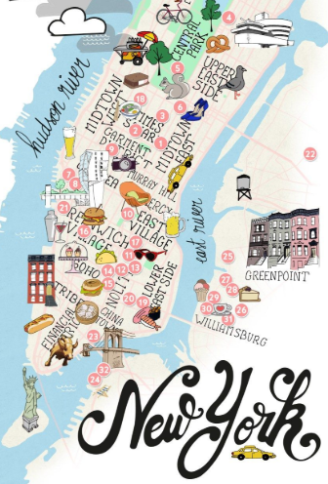
AIRBNB HOT SPOTS Project 1 1/12/19
ERIC LIEU
MJ VILLACRESES
FRANCIS IMPERIAL
AMANDA WISHNIE

Slide 2
RESEARCH QUESTIONS TO ANSWER
PRIMARY QUESTION What affects AirBnB prices?
ADDITIONAL QUESTIONS Does the temperature affect prices? Does the amount of crime affect prices? Does median household income affect prices? Do demographics (i.e. ethnicity & age) affect prices?
MOTIVATIONS:
UNDERSTAND WHAT EXTERNAL FACTORS AFFECT AIRBNB PRICES
WHERE:
AIRBNB OPEN SOURCE
US CENSUS BUREAU DATA
AMERICAN COMMUNITY SURVEY
ACCUWEATHER
NYC OPEN DATA
HOW:
EXCEL
PYTHON
API’s

Slide 3
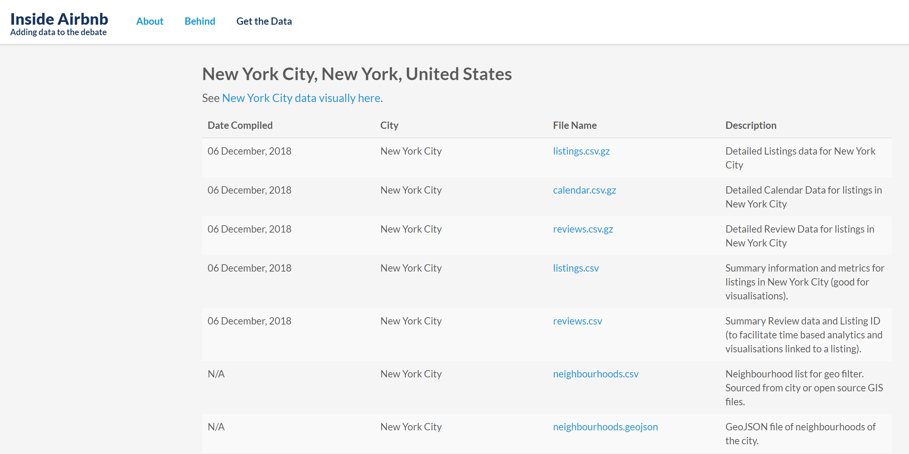
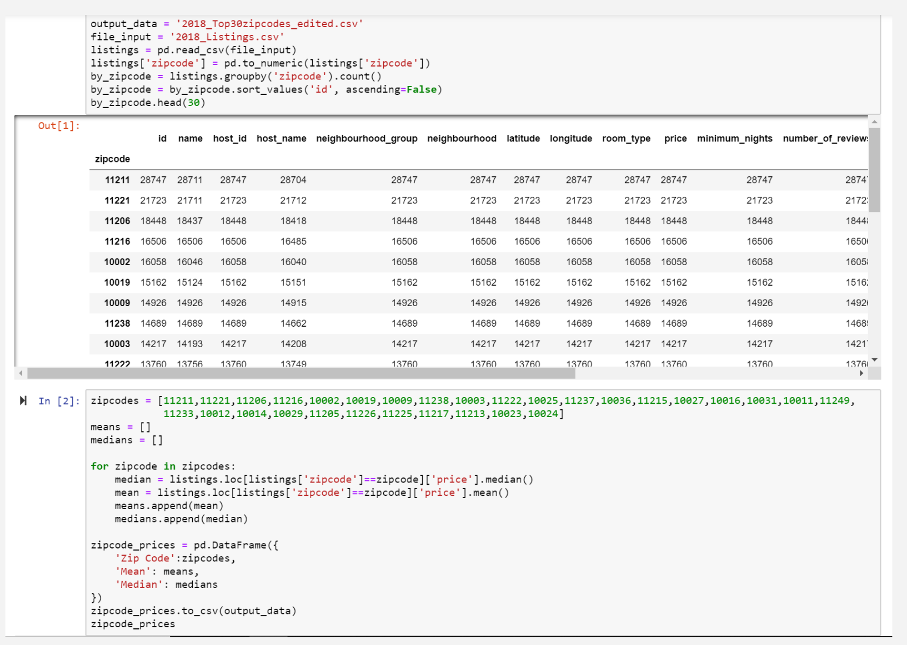
1
2
HOW?

Slide 4
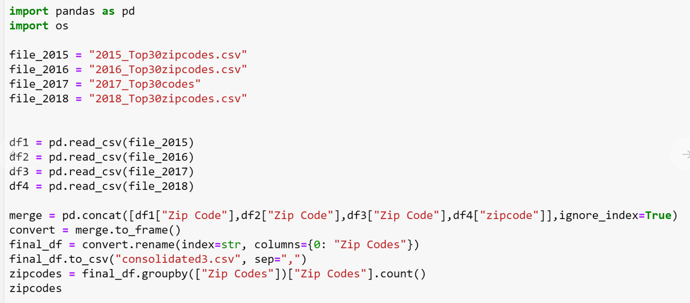
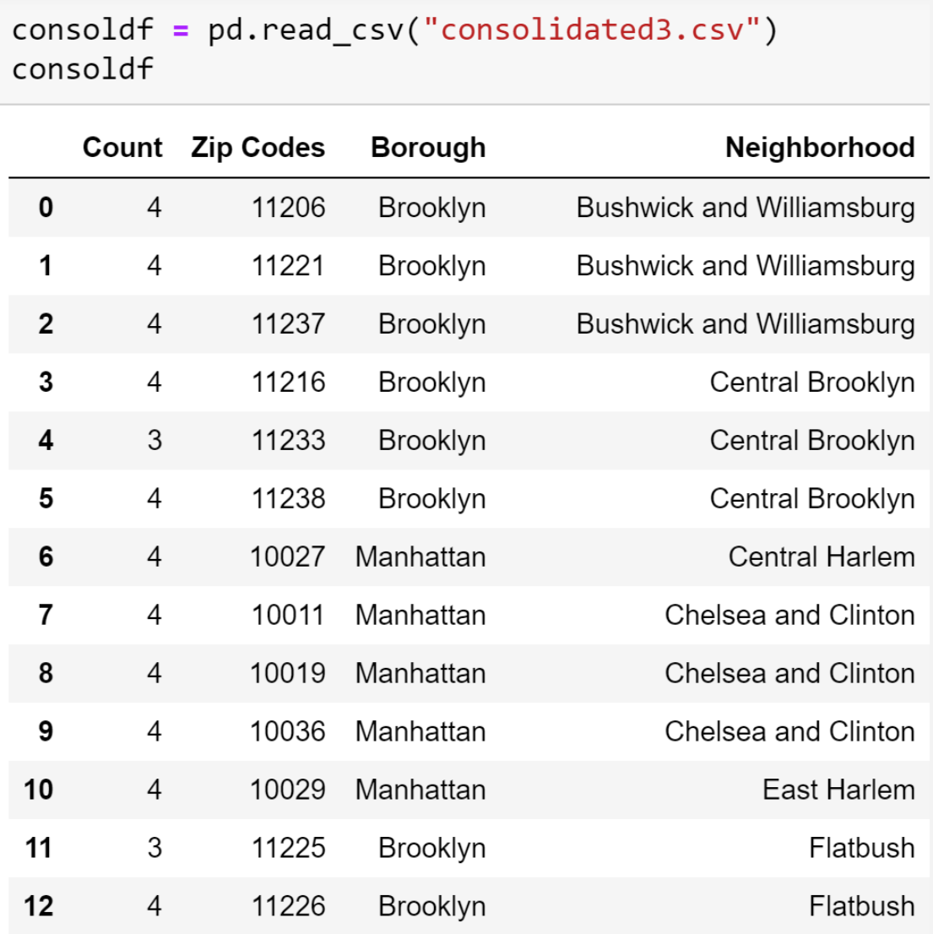
3
4
PRELIMINARY DATA

Slide 5






Does temperature affect prices?
MJ VILLACRESES

Slide 6
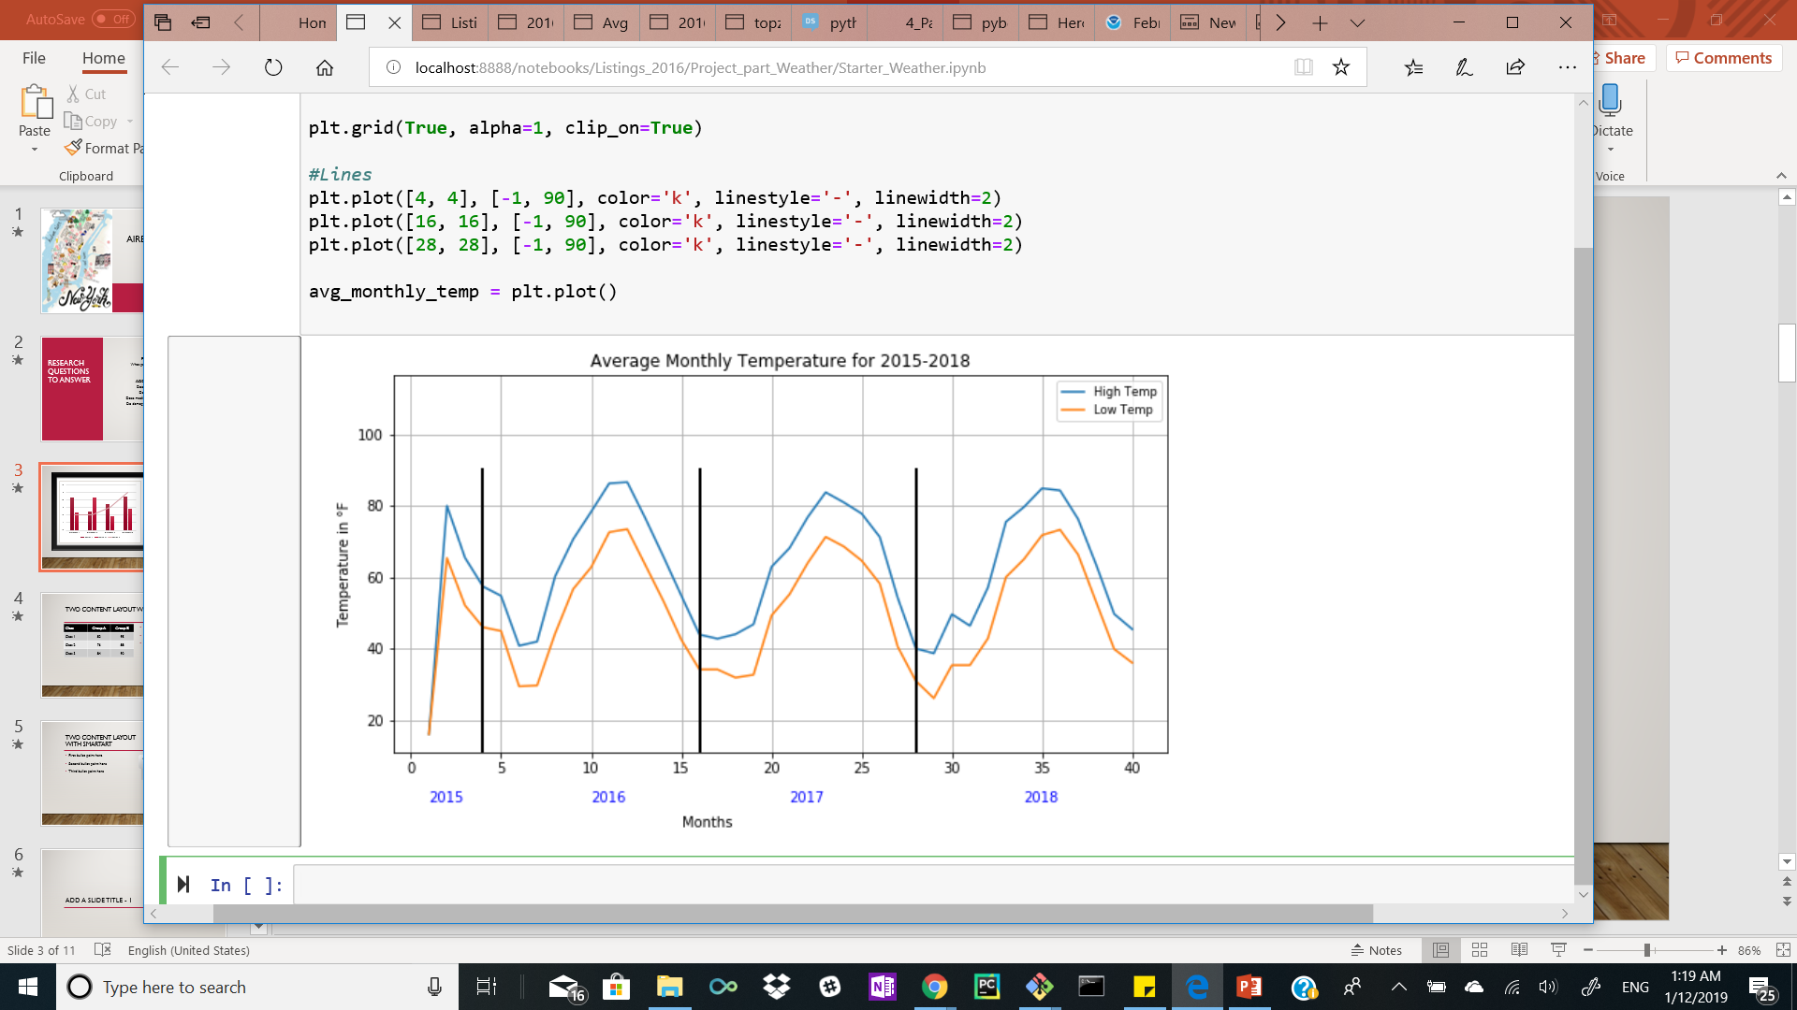
Trend for average monthly temperature
As it is expected, temperature fluctuates according to the seasons
Lowest temperatures in NYC show up in January and February 2018, then 2016 and lastly 2017.
Highest temperature remain relatively the same throughout all summers with one discrepancy during 2015, when avg temp remained just below the 80° mark.

Slide 7
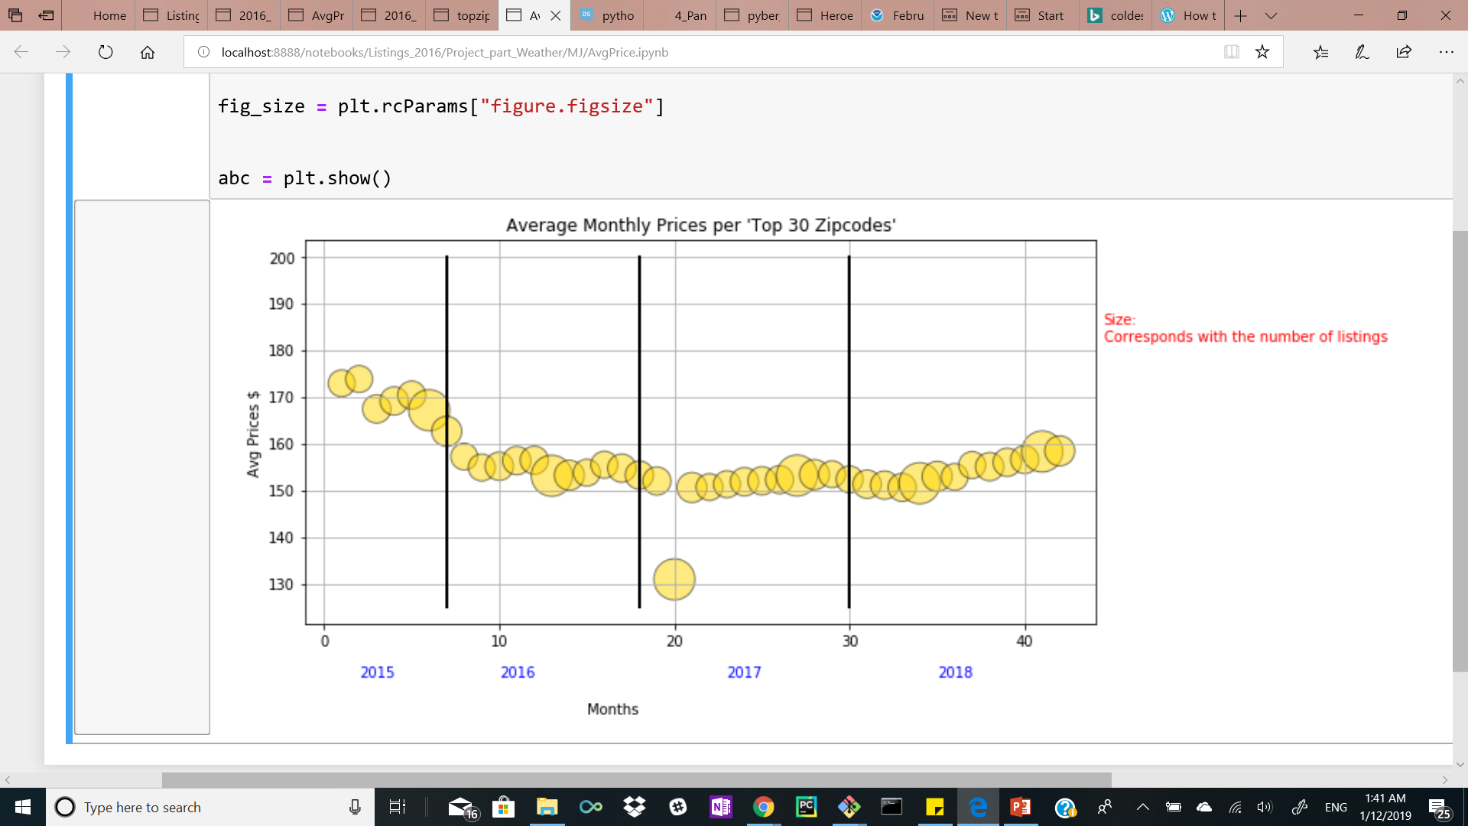
Average AirBnB monthly Price per night from 2015-2018
Number of listings has no correlation with current temperature
Avg. Price has decreased over the years, slight increase over the summer.
Feb 9, 2017 – major pitfall in Avg. Price.

Slide 8





Does the amount of crime affect prices?
ERIC LIEU

Slide 9
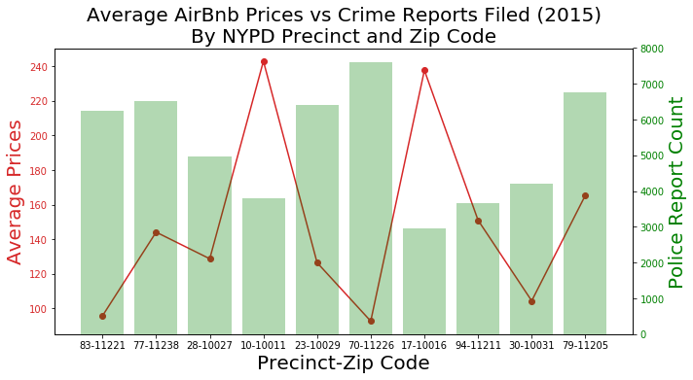
Average Airbnb prices & number of complaints filed at nypd precinct
AirBnB Data (CSV):
Yearly average prices for selected list of zip codes
NYC OPEN DATA (API JSON):
Queried and returned number of police reports (e.g. violations, misdemeanors, felonies) filed for each select precinct for entire year
Precincts were chosen based on the selected list of selected list of zip codes

Slide 10
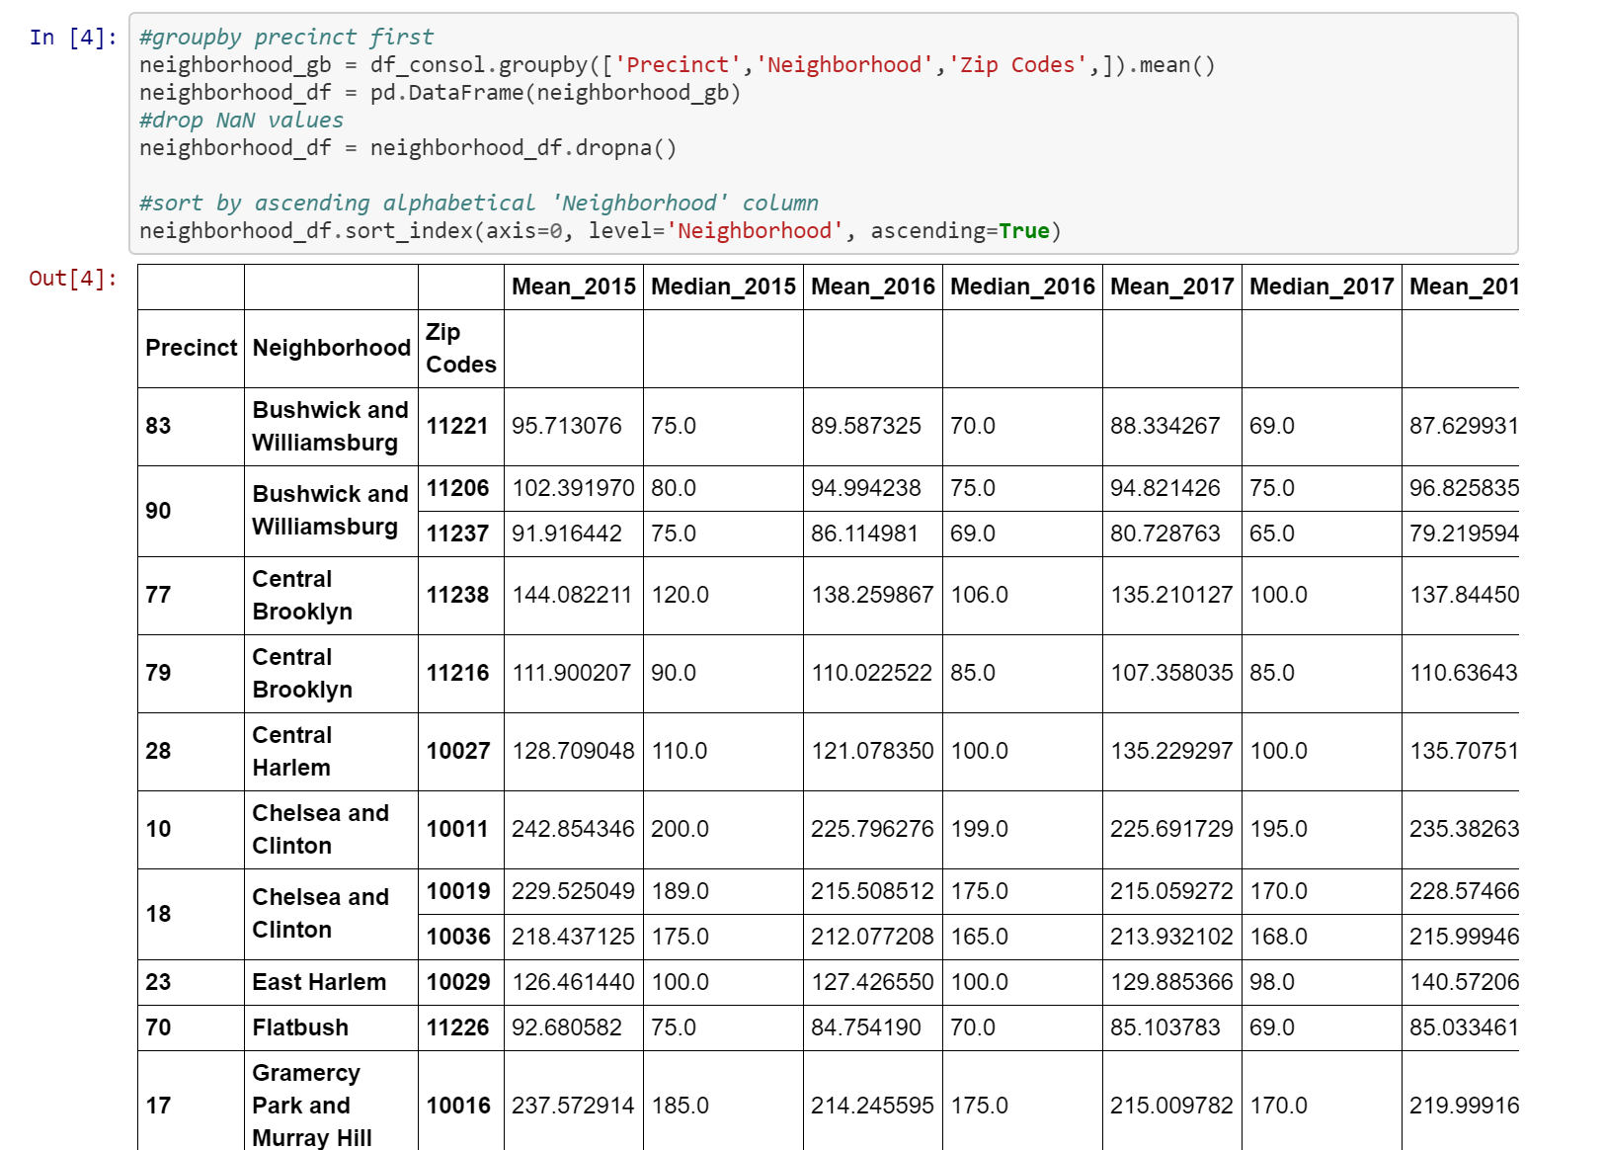
Brief overview of code input and output

Slide 11
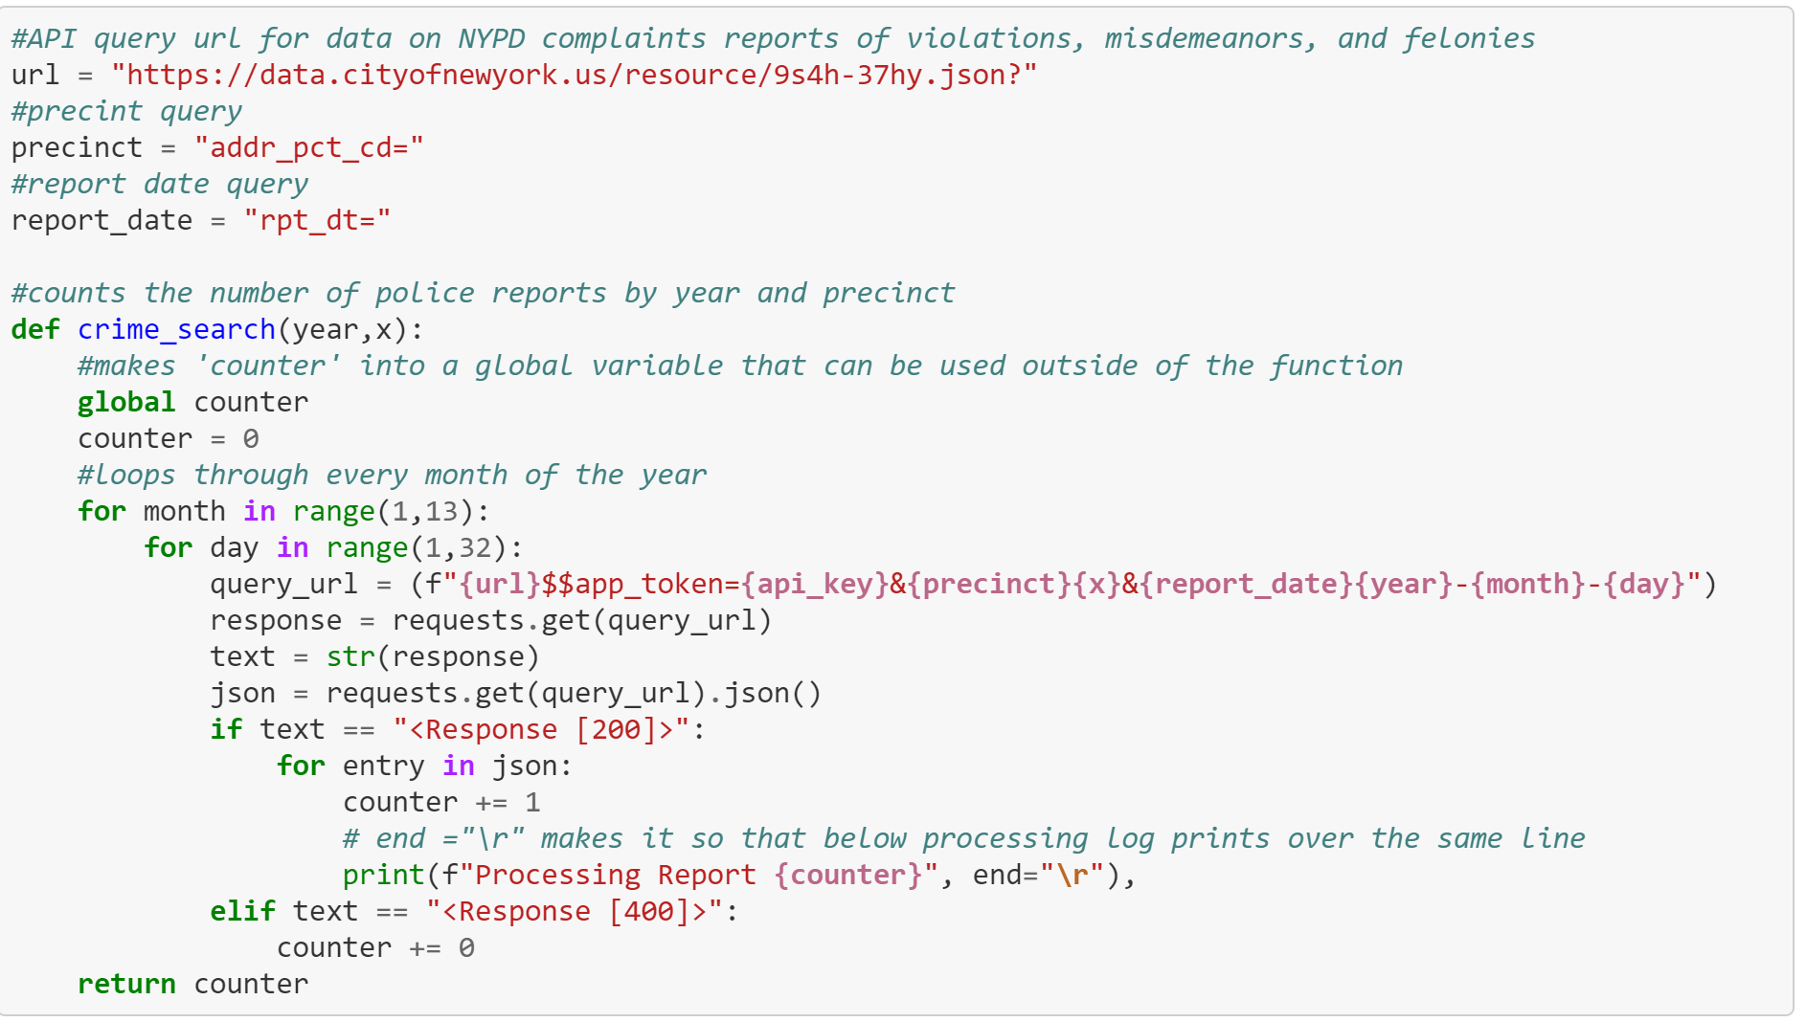
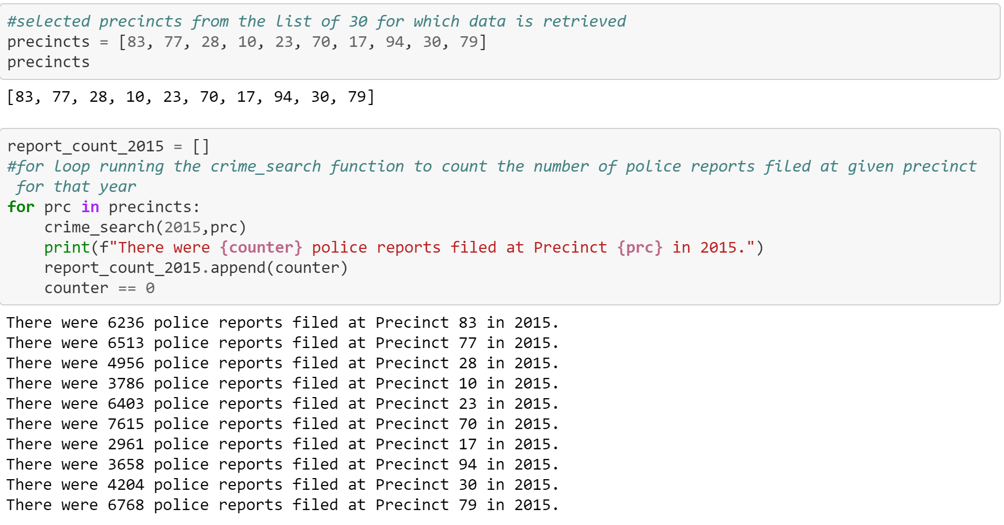
Brief overview of code input and output

Slide 12
gss
Chelsea and Clinton
Gramercy Park and Murray Hill
Northwest Brooklyn
Washington Heights
Bushwick and Williamsburg
Flatbush

Slide 13
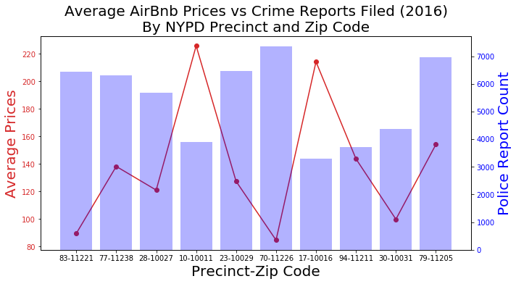

Slide 14
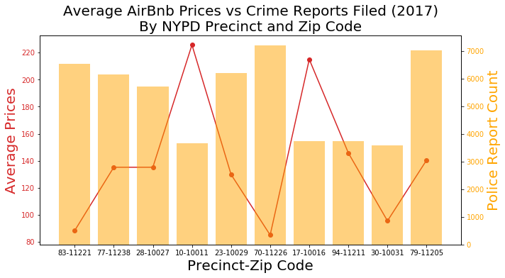

Slide 15





Does median household income affect prices?
AMANDA WISHNIE

Slide 16
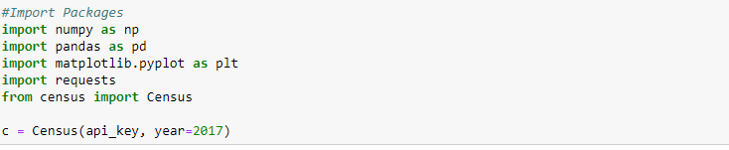
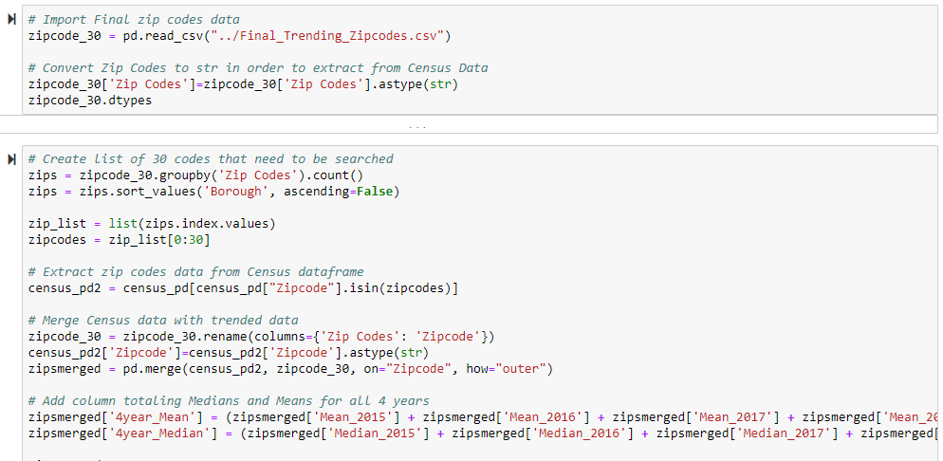
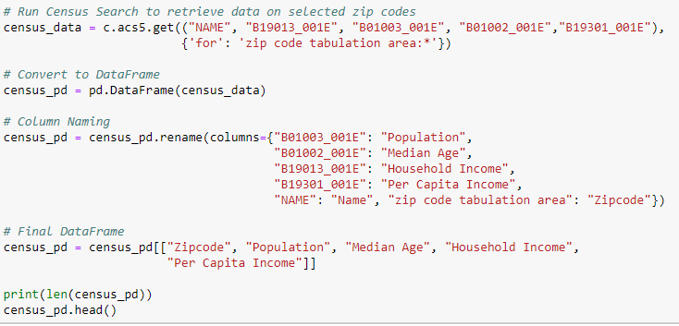
JUPYTER NOTEBOOK
CENSUS DATA
ZIPCODES & CENSUS DATA

Slide 17
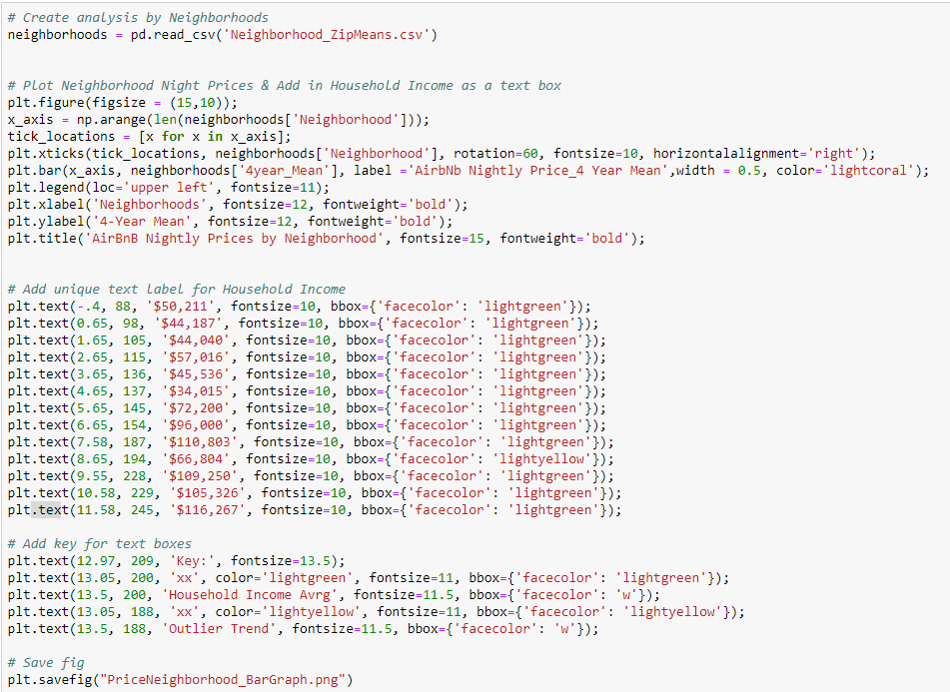
BAR GRAPH
DataFrame grouped by Neighborhood
Calculated the 4 year Mean for AirBnB Prices
Compare Prices & HH Income (2013 – 2017)

Slide 18
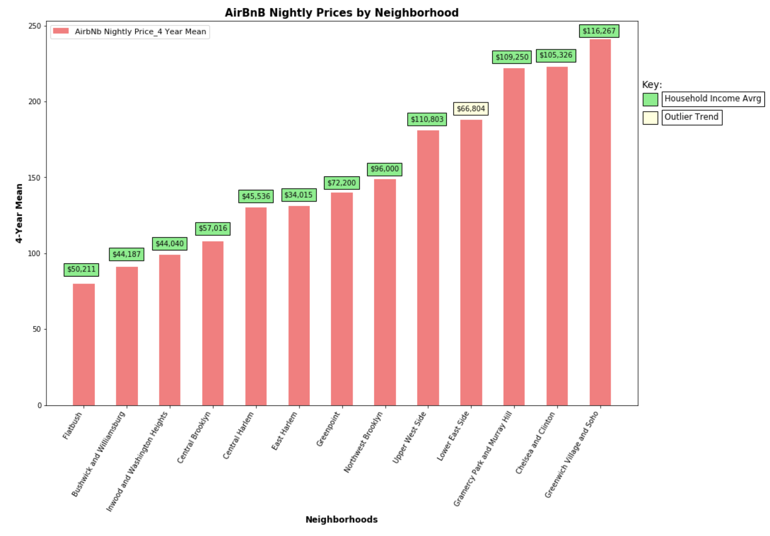
hh Income & Price by neighborhood
Lower Income = Lower AirBnB Prices
Outlier Trend = Lower East Side
Source: 2013-2017 American Community Survey 5-Year Estimates & AirBnB

Slide 19
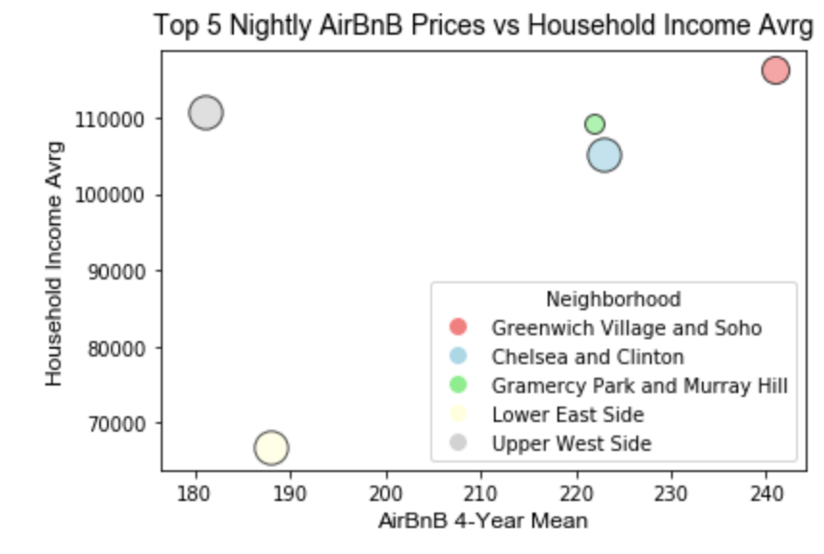
OUTLIER TREND:
Lower east side
Amongst the Top 5 AirBnB Prices
$34K average Household Income
Neighborhood | AirBnB Avrg Price | HH Income Avrg
Greenwich Village & Soho | $241 | $116,267
Chelsea & Clinton | $223 | $105,326
Gramercy Park & Murray Hill | $222 | $109,250
Lower East Side | $188 | $66,804
Upper West Side | $181 | $110,803
TOP 5 AVRG | $211 | $101,690
$101,690 - $66,804 = $34,886
Source: 2013-2017 American Community Survey 5-Year Estimates & AirBnB

Slide 20




Do demographics (i.e. ethnicity) affect prices?
FRANCIS IMPERIAL

Slide 21
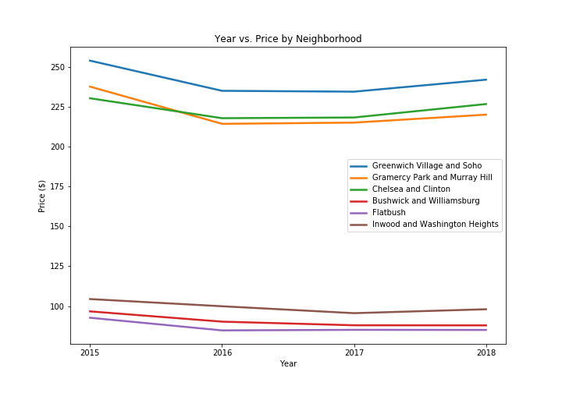
Year vs. Price by neighborhood

Slide 22
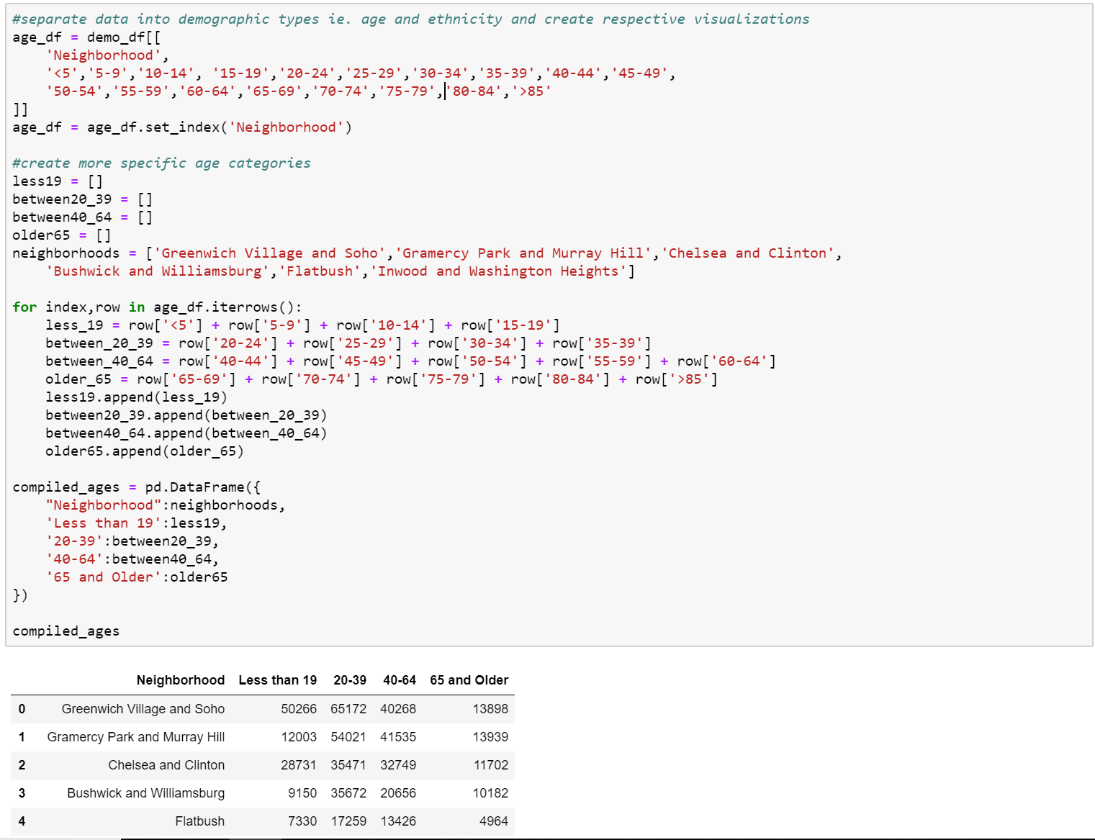
Age demographic Data cleansing

Slide 23
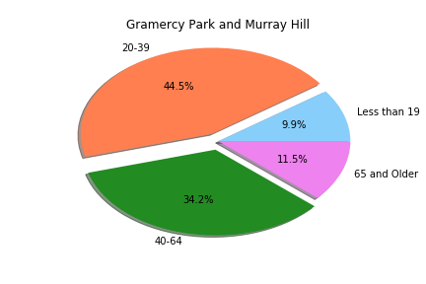
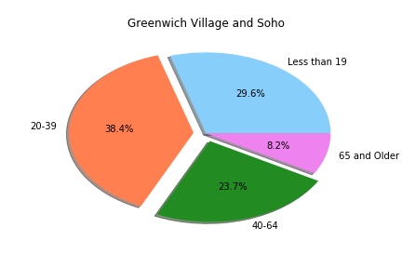
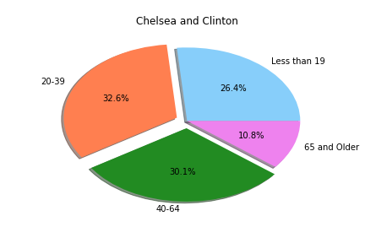
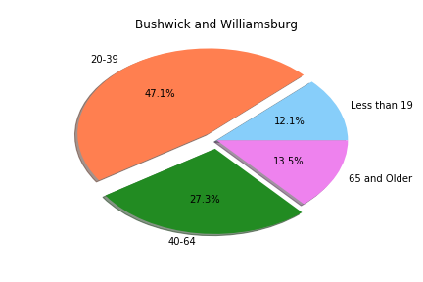
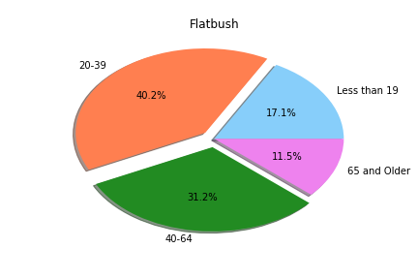
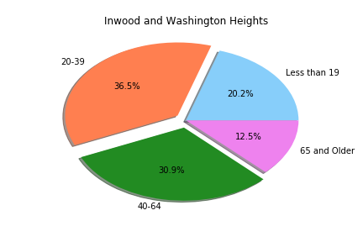
Demographics by age
High
Low

Slide 24
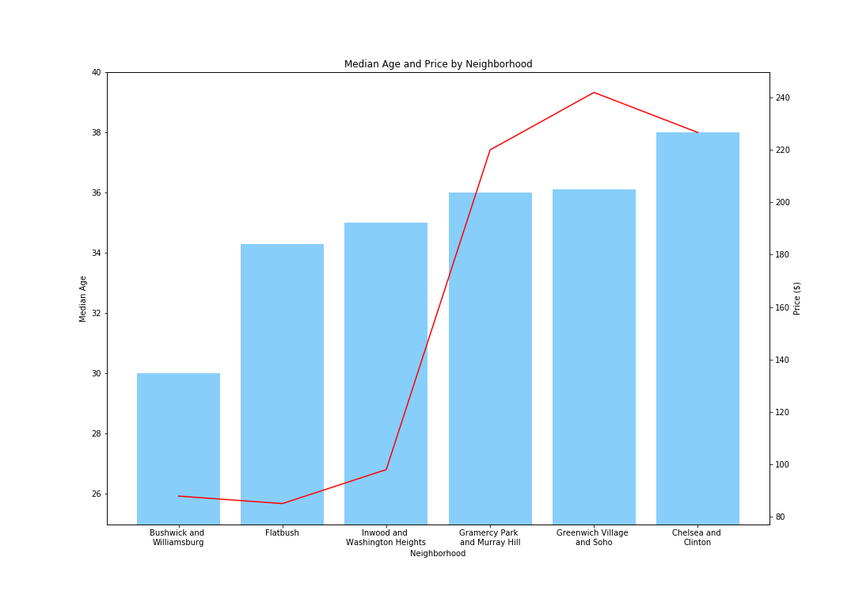
Median age and price by neighborhood

Slide 25
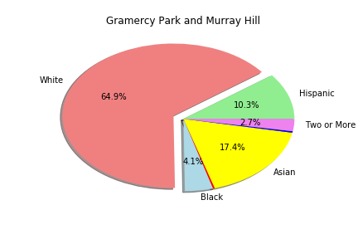
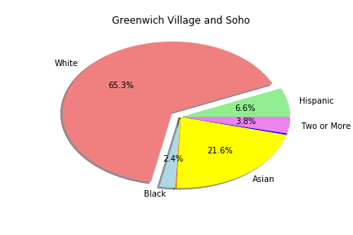
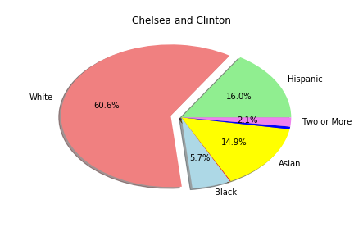
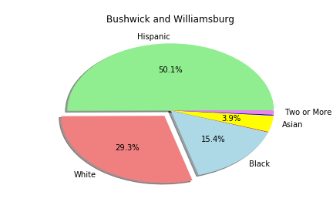
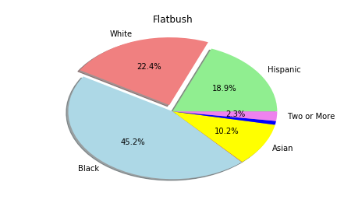
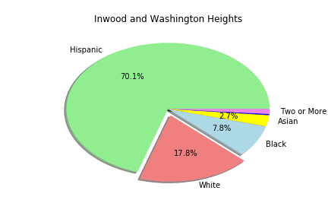
Demographics by Race
High
Low

Slide 26
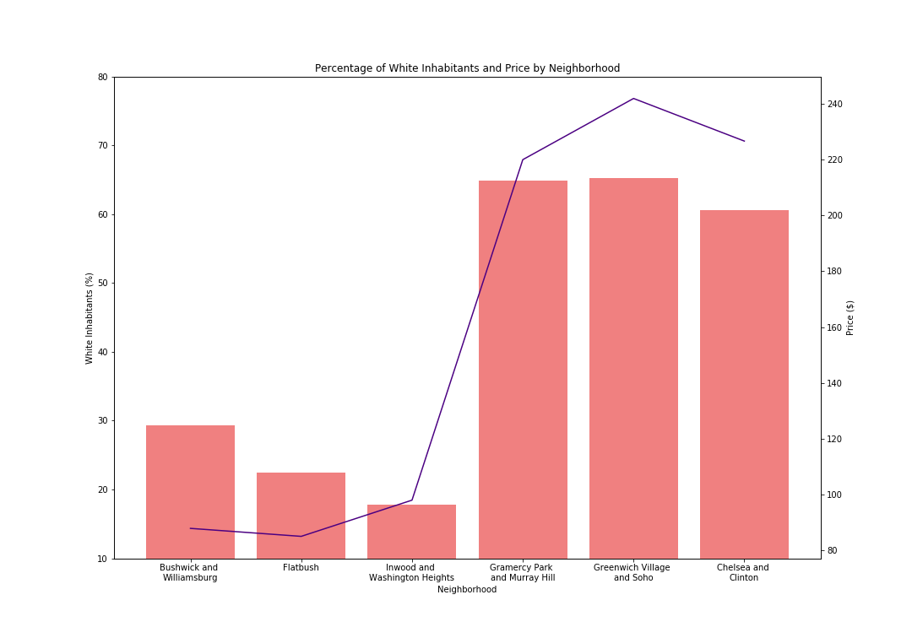
Percentage of white inhabitants and price by neighborhood

Slide 27
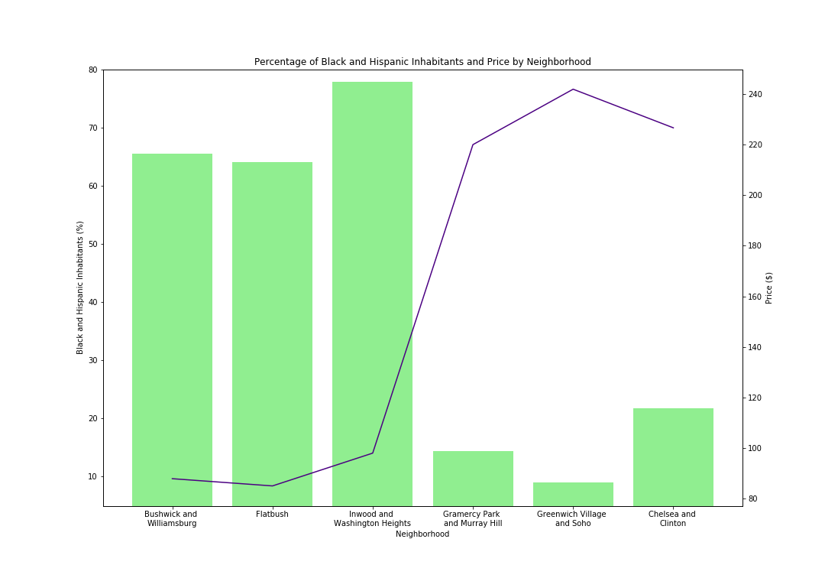
Percentage of black and Hispanic inhabitants and price by neighborhood

Slide 28
AIRBNB HOT SPOT CONCLUSIONS
TIME OF THE YEAR:
NUMBER OF LISTINGS DOESN’T CORRELATE WITH TEMPERATURE
MAJOR EVENTS DIRECTY AFFECT PRICE
FEB’17 BLIZZARD = DROP IN PRICE
Apt Owner
Time of Year
HH Income
Demographics
Crime Rates
CRIME RATES:
HIGHER AMOUNTS OF CRIME REPORTS FILED GENERALLY CORRESPONDED WITH LOWER AVERAGE PRICES
LOWER AMOUNTS OF CRIME REPORTS FILED GENERALLY CORRESPONDED WITH HIGHER AVERAGE PRICES
HH INCOME:
HH INCOME DIRECTLY CORRELATES WITH AIRBNB PRICES
AIRBNB PRICES THAT AREN’T INLINE WITH HH INCOME SUGGESTS THERE MAY BE EXTERNAL FACTORS AFFECTING THE AIRBNB PRICES
DEMOGRAPHICS:
MEDIAN AGE CORRELATES WITH AIRBNB PRICES
PERCENTAGE OF WHITE INHABITANTS STRONGLY CORRELATES WITH AIRBNB PRICES
BLACK AND HISPANIC COUNTERPARTS STRONGLY INVERSELY CORRELATES WITH AIRBNB PRICES

